Slide 1
Counting
Chapter 6
Mr. Shoaib Raza

Slide 2
Chapter Summary
The Basics of Counting
The Pigeonhole Principle
Permutations and Combinations
Binomial Coefficients and Identities
Generalized Permutations and Combinations

Slide 3
The Basics of Counting
Section 6.1

Slide 4
COMBINATORICS
Combinatorics is the mathematics of counting and arranging objects. Counting of objects with certain properties (enumeration) is required to solve many different types of problem.
Applications, include topics as diverse as codes, circuit design and algorithm complexity [and gambling]

Slide 5
Counting
Enumeration, the counting of objects with certain properties, is an important part of combinatorics.
We must count objects to solve many different types of problems. For example, counting is used to:
Determine number of ordered or unordered arrangement of objects.
Generate all the arrangements of a specified kind which is important in computer simulations.
Compute probabilities of events.
Analyze the chance of winning games, lotteries etc.
Determine the complexity of algorithms.

Slide 6
Section Summary
The Sum Rule
The Product Rule
The Subtraction Rule
The Division Rule
Examples, Examples, and Examples
Tree Diagrams

Slide 7
Basic Counting Principles: The Sum Rule
The Sum Rule: If a task can be done either in one of n₁ ways or in one of n₂ ways to do the second task, where none of the set of n₁ ways is the same as any of the n₂ ways, then there are n₁ + n₂ ways to do the task.

Slide 8
The Sum Rule in terms of sets.
The sum rule can be phrased in terms of sets.
|A ∪ B|= |A| + |B| as long as A and B are disjoint sets.
Or more generally,
The case where the sets have elements in common will be discussed when we consider the subtraction rule and taken up fully in Chapter 8.
|A₁ ∪ A₂ ∪ ∙∙∙ ∪ A_{m} |= |A₁| + |A₂| + ∙∙∙ + |A_{m}|
when A_{i} ∩ A_{j} = ∅ for all i, j.

Slide 9
Basic Counting Principles: The Sum Rule
Example:
Suppose there are 7 different optional courses in Computer Science and 3 different optional courses in Mathematics. Then there are 7 + 3 = 10 choices for a student who wants to take one optional course.
Solution: By the sum rule it follows that there are 7 + 3 = 10 choices for a student who wants to take one optional course.

Slide 10
Basic Counting Principles: The Sum Rule
Example: The mathematics department must choose either a student or a faculty member as a representative for a university committee. How many choices are there for this representative if there are 37 members of the mathematics faculty and 83 mathematics majors and no one is both a faculty member and a student.
Solution: By the sum rule it follows that there are 37 + 83 = 120 possible ways to pick a representative.

Slide 11
Basic Counting Principles: The Sum Rule
Example: A student can choose a computer project from one of the three lists. The three lists contain 23, 15 and 19 possible projects, respectively. How many possible projects are there to choose from?
Solution: The student can choose a project from the first list in 23 ways, from the second list in 15 ways, and from the third list in 19 ways. Hence, there are
23 + 15 + 19 = 57 projects to choose from.

Slide 12
Basic Counting Principles: The Product Rule
The Product Rule: A procedure can be broken down into a sequence of two tasks. There are n₁ ways to do the first task and n₂ ways to do the second task. Then there are n₁∙n₂ ways to do the procedure.

Slide 13
Product Rule in Terms of Sets
If A₁, A₂, … , A_{m} are finite sets, then the number of elements in the Cartesian product of these sets is the product of the number of elements of each set.
The task of choosing an element in the Cartesian product A₁ ⨉ A₂ ⨉ ∙∙∙ ⨉ A_{m} is done by choosing an element in A₁, an element in A₂ , …, and an element in A_{m}.
By the product rule, it follows that:
|A₁ ⨉ A₂ ⨉ ∙∙∙ ⨉ A_{m} |= |A₁| ∙ |A₂| ∙ ∙∙∙ ∙ |A_{m}|.

Slide 14
The Product Rule
Example: How many ways a student can choose one optional course each from computer science and mathematics courses if there are 7 different optional courses in Computer Science and 3 different optional courses in Mathematics.
Solution:
A student who wants to take one optional course of each subject, there are 7 × 3 = 21 choices.

Slide 15
The Product Rule
Example: The chairs of an auditorium are to be labeled with two characters, a letter followed by a digit. What is the largest number of chairs that can be labeled differently?
Solution:
The procedure of labeling a chair consists of two events, namely,
Assigning one of the 26 letters: A, B, C, …, Z and
Assigning one of the 10 digits: 0, 1, 2, …, 9
By product rule, there are 26 × 10 = 260 different ways that a chair can be labeled by both a letter and a digit.

Slide 16
The Product Rule
Example: Find the number n of ways that an organization consisting of 15 members can elect a president, treasurer, and secretary. (assuming no person is elected to more than one position)
Solution:
The president can be elected in 15 different ways; following this, the treasurer can be elected in 14 different ways; and following this, the secretary can be elected in 13 different ways. Thus, by product rule, there are
n = 15 × 14 × 13 = 2730
different ways in which the organization can elect the officers.

Slide 17
The Product Rule
Example: There are four bus lines between A and B; and three bus lines between B and C.
Find the number of ways a person can travel:
a) By bus from A to C by way of B;
b) Round trip by bus from A to C by way of B;
c) Round trip by bus from A to C by way of B, if the person does not want to use a bus line more than once.

Slide 18
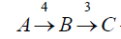
The Product Rule
a) By bus from A to C by way of B;
Solution:
There are 4 ways to go from A to B and 3 ways to go from B to C; hence there are 4 × 3 = 12 ways to go from A to C by way of B.

Slide 19
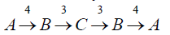
The Product Rule
b) Round trip by bus from A to C by way of B;
Solution:
The person will travel from A to B to C to B to A for the round trip. i.e. (A →B →C →B →A)
The person can travel 4 ways from A to B and 3 way from B to C and back.
Thus there are 4 ×3 ×3 × 4 = 144 ways to travel the round trip.

Slide 20
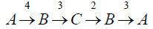
The Product Rule
c) Round trip by bus from A to C by way of B, if the person does not want to use a bus line more than once.
Solution:
The person can travel 4 ways from A to B and 3 ways from B to C, but only 2 ways from C to B and 3 ways from B to A, since bus line cannot be used more than once. Hence there are
4 ×3 ×2 × 3 = 72 ways
to travel the round trip without using a bus line more than once.

Slide 21

The Product Rule
Example: A bit string is a sequence of 0’s and 1’s.How many bit string are there of length 4?
Solution:
Each bit (binary digit) is either 0 or 1.
Hence, there are 2 ways to choose each bit. Since we have to choose four bits therefore,
the product rule shows, there are a total of different bit strings of length four.

Slide 22
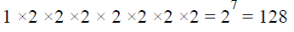
The Product Rule
Example: How many bit strings of length 8:
(i ) begin with a 1?
(ii) begin and end with a 1?
Solution:
(i) If the first bit (left most bit) is a 1, then it can be filled in only one way. Each of the remaining seven positions in the bit string can be filled in 2 ways (i.e., either by 0 or 1). Hence, there are
different bit strings of length 8 that begin with a 1.

Slide 23
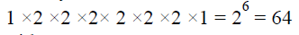
The Product Rule
(ii) begin and end with a 1?
Solution:
If the first and last bit in an 8 bit string is a 1, then only the intermediate six bits can be filled in 2 ways, i.e. by a 0 or 1. Hence there are
different bit strings of length 8 that begin and end with a 1.

Slide 24
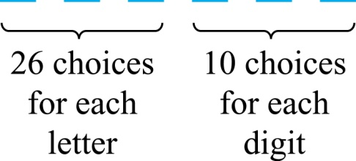
The Product Rule
Example: How many different license plates can be made if each plate contains a sequence of three uppercase English letters followed by three digits?
Solution: By the product rule,
there are 26 ∙ 26 ∙ 26 ∙ 10 ∙ 10 ∙ 10 = 17,576,000 different possible license plates.

Slide 25
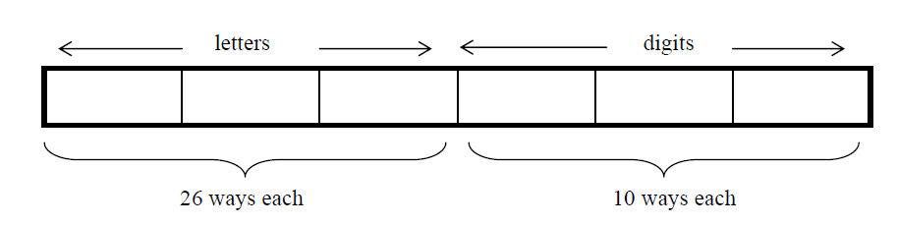
The Product Rule
Example: Suppose that an automobile license plate has three letters followed by three digits.
(a) How many different license plates are possible?
Solution:
Each of the three letters can be written in 26 different ways, and each of the three digits can be written in 10 different ways.
Hence, by the product rule, there is a total of
26 × 26 × 26 × 10 × 10 × 10 = 17,576,000
different License plates possible.

Slide 26
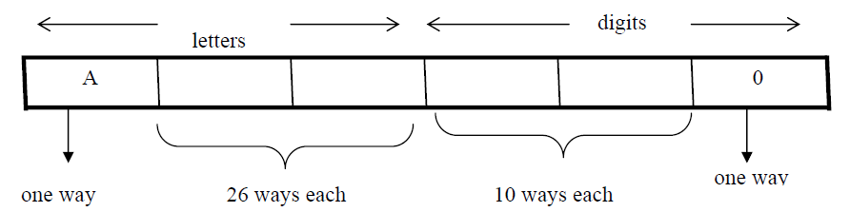
The Product Rule
(b) How many license plates could begin with A and
end on 0?
Solution:
The first and last place can be filled in one way only, while each of second and third place can be filled in 26 ways and each of fourth and fifth place can be filled in 10 ways.
Number of license plates that begin with A and end in 0 are
1 × 26 × 26 × 10 × 10 × 1 = 67600

Slide 27
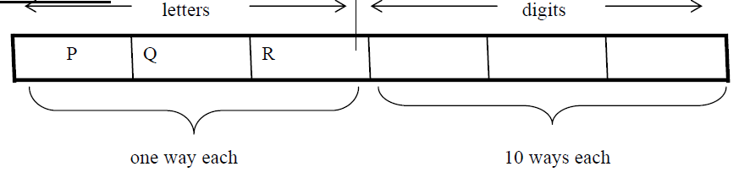
The Product Rule
(c) How many license plates begin with PQR.
Solution:
Number of license plates that begin with PQR are
1 × 1 × 1 × 10 × 10 × 10 = 1000 ways.

Slide 28
The Product Rule
(d) How many license plates are possible in which all the letters and digits are distinct?
Solution:
The first letter place can be filled in 26 ways. Since, the second letter place should contain a different letter than the first, so it can be filled in 25 ways. Similarly, the third letter place can be filled in 24 ways. And the digits can be respectively filled in 10, 9, and 8 ways.
Hence;
number of license plates in which all the letters and digits are distinct are
26 × 25 × 24 × 10 × 9 × 8 = 11, 232, 000

Slide 29
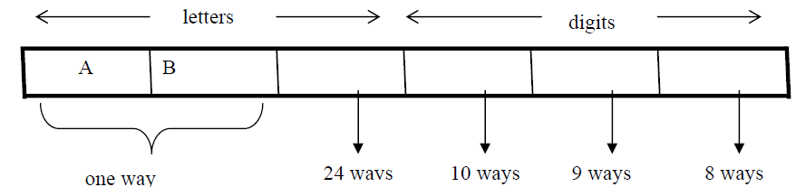
The Product Rule
(e) How many license plates could begin with AB and have all three letters and digits distinct.
Solution:
The first two letters places are fixed (to be filled with A and B), so there is only one way to fill them. The third letter place should contain a letter different from A & B, so there
are 24 ways to fill it.
The three digit positions can be filled in 10 and 8 ways to have distinct digits. Hence, desired number of license plates are
1 × 1 × 24 × 10 × 9 × 8 = 17280

Slide 30
Counting Functions
Counting Functions: How many functions are there from a set with m elements to a set with n elements?
Solution: Since a function represents a choice of one of the n elements of the codomain for each of the m elements in the domain, the product rule tells us that there are n ∙ n ∙ ∙ ∙ n = n^{m} such functions.
Counting One-to-One Functions: How many one-to-one functions are there from a set with m elements to one with n elements?
Solution: Suppose the elements in the domain are a₁, a₂,…, a_{m}. There are n ways to choose the value of a₁ and n−1 ways to choose a₂, etc. The product rule tells us that there are n(n−1) (n−2)∙∙∙(n−m +1) such functions.

Slide 31
Telephone Numbering Plan
Example: The North American numbering plan (NANP) specifies that a telephone number consists of 10 digits, consisting of a three-digit area code, a three-digit office code, and a four-digit station code. There are some restrictions on the digits.
Let X denote a digit from 0 through 9.
Let N denote a digit from 2 through 9.
Let Y denote a digit that is 0 or 1.
In the old plan (in use in the 1960s) the format was NYX-NNX-XXXX.
In the new plan, the format is NXX-NXX-XXXX.
How many different telephone numbers are possible under the old plan and the new plan?
Solution: Use the Product Rule.
There are 8 ∙2 ∙10 = 160 area codes with the format NYX.
There are 8 ∙10 ∙10 = 800 area codes with the format NXX.
There are 8 ∙8 ∙10 = 640 office codes with the format NNX.
There are 10 ∙10 ∙10 ∙10 = 10,000 station codes with the format XXXX.
Number of old plan telephone numbers: 160 ∙640 ∙10,000 = 1,024,000,000.
Number of new plan telephone numbers: 800 ∙800 ∙10,000 = 6,400,000,000.

Slide 32
Counting Subsets of a Finite Set
Counting Subsets of a Finite Set: Use the product rule to show that the number of different subsets of a finite set S is 2^{|S|}. (In Section 5.1, mathematical induction was used to prove this same result.)
Solution: When the elements of S are listed in an arbitrary order, there is a one-to-one correspondence between subsets of S and bit strings of length |S|. When the ith element is in the subset, the bit string has a 1 in the ith position and a 0 otherwise.
By the product rule, there are 2^{|S|} such bit strings, and therefore 2^{|S|} subsets.

Slide 33
DNA and Genomes
A gene is a segment of a DNA molecule that encodes a particular protein and the entirety of genetic information of an organism is called its genome.
DNA molecules consist of two strands of blocks known as nucleotides. Each nucleotide is composed of bases: adenine (A), cytosine (C), guanine (G), or thymine (T).
The DNA of bacteria has between 10⁵ and 10⁷ links (one of the four bases). Mammals have between 10⁸ and 10¹⁰ links. So, by the product rule there are at least 4¹⁰⁵ different sequences of bases in the DNA of bacteria and 4¹⁰⁸ different sequences of bases in the DNA of mammals.
The human genome includes approximately 23,000 genes, each with 1,000 or more links.
Biologists, mathematicians, and computer scientists all work on determining the DNA sequence (genome) of different organisms.

Slide 34
Combining the Sum and Product Rule
Example: Suppose statement labels in a programming language can be either a single letter or a letter followed by a digit. Find the number of possible labels.
Solution:
First consider variable names one character in length. Since such names consist of a single letter, there are 26 variable names of length 1.
Next, consider variable names two characters in length. Since the first character is a letter, there are 26 ways to choose it. The second character is a digit, there are 10 ways to choose it. Hence, to construct variable name of two characters in length, there are 26×10 = 260 ways.
Finally, by sum rule, there are 26 + 260 = 286 possible variable names in the programming language.

Slide 35
Counting Passwords
Combining the sum and product rule allows us to solve more complex problems.
Example: Each user on a computer system has a password, which is six to eight characters long, where each character is an uppercase letter or a digit. Each password must contain at least one digit. How many possible passwords are there?
Solution: Let P be the total number of passwords, and let P₆, P₇, and P₈ be the passwords of length 6, 7, and 8.
By the sum rule P = P₆ + P₇ +P₈.
To find each of P₆, P₇, and P₈ , we find the number of passwords of the specified length composed of letters and digits and subtract the number composed only of letters. We find that:
P₆ = 36⁶ − 26⁶ = 2,176,782,336 − 308,915,776 =1,867,866,560.
P₇ = 36⁷ − 26⁷ = 78,364,164,096 − 8,031,810,176 = 70,332,353,920.
P₈ = 36⁸ − 26⁸ = 2,821,109,907,456 − 208,827,064,576 =2,612,282,842,880.
Consequently, P = P₆ + P₇ +P₈ = 2,684,483,063,360.

Slide 36
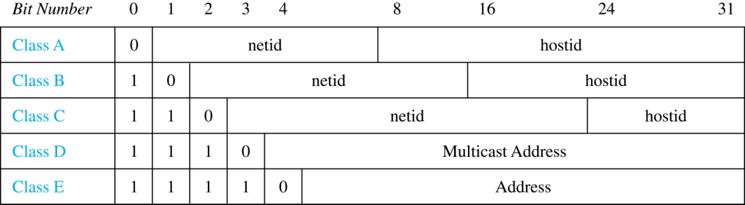
Internet Addresses
Version 4 of the Internet Protocol (IPv4) uses 32 bits.
Class A Addresses: used for the largest networks, a 0,followed by a 7-bit netid and a 24-bit hostid.
Class B Addresses: used for the medium-sized networks, a 10,followed by a 14-bit netid and a 16-bit hostid.
Class C Addresses: used for the smallest networks, a 110,followed by a 21-bit netid and a 8-bit hostid.
Neither Class D nor Class E addresses are assigned as the address of a computer on the internet. Only Classes A, B, and C are available.
1111111 is not available as the netid of a Class A network.
Hostids consisting of all 0s and all 1s are not available in any network.

Slide 37
Counting Internet Addresses
Example: How many different IPv4 addresses are available for computers on the internet?
Solution: Use both the sum and the product rule. Let x be the number of available addresses, and let x_{A}, x_{B}, and x_{C} denote the number of addresses for the respective classes.
To find, x_{A}: 2⁷ − 1 = 127 netids. 2²⁴ − 2 = 16,777,214 hostids.
x_{A} = 127∙ 16,777,214 = 2,130,706,178.
To find, x_{B}: 2¹⁴ = 16,384 netids. 2¹⁶ − 2 = 16,534 hostids.
x_{B} = 16,384 ∙ 16, 534 = 1,073,709,056.
To find, x_{C}: 2²¹ = 2,097,152 netids. 2⁸ − 2 = 254 hostids.
x_{C} = 2,097,152 ∙ 254 = 532,676,608.
Hence, the total number of available IPv4 addresses is
x = x_{A} + x_{B} + x_{C}
= 2,130,706,178 + 1,073,709,056 + 532,676,608
= 3, 737,091,842.
Not Enough Today !!
The newer IPv6 protocol solves the problem of too few addresses.

Slide 38
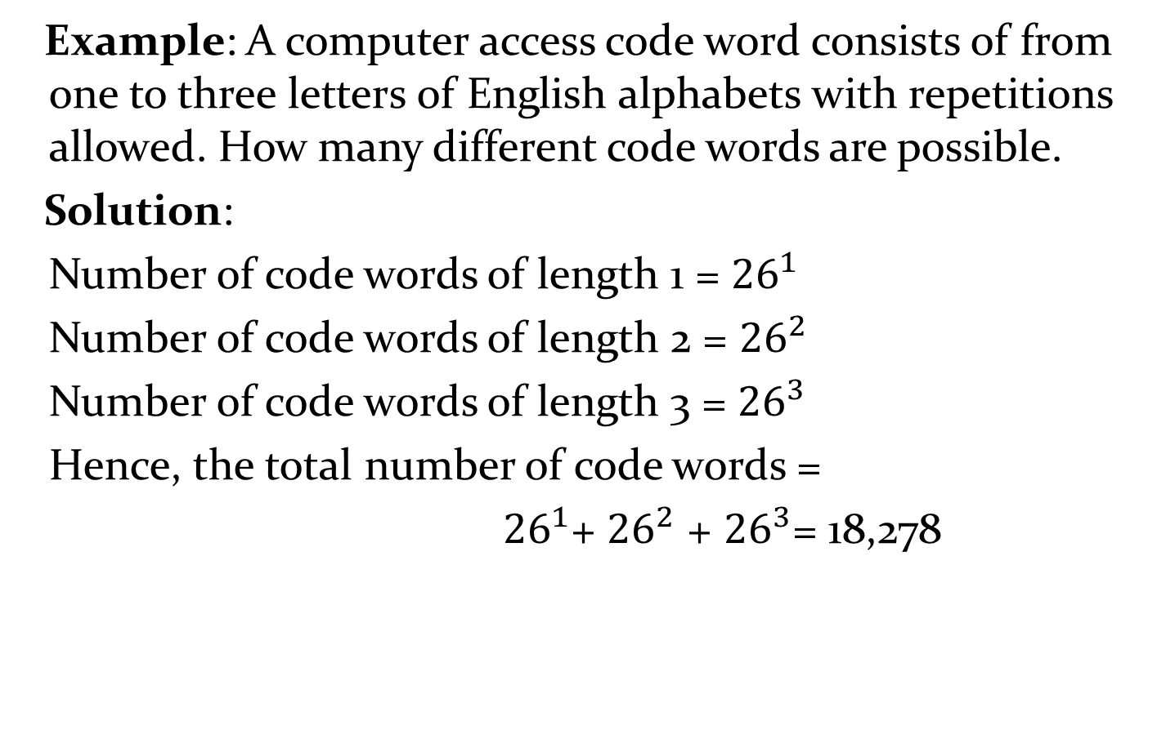
Combining the Sum and Product Rule
Example: A computer access code word consists of from one to three letters of English alphabets with repetitions allowed. How many different code words are possible.
Solution:
Number of code words of length 1 = ${26}^{1}$
Number of code words of length 2 = ${26}^{2}$
Number of code words of length 3 = ${26}^{3}$
Hence, the total number of code words =
${26}^{1}$+ ${26}^{2}$ + ${26}^{3}$= 18,278

Slide 39
NUMBER OF ITERATIONS OF A NESTED LOOP
Example: Determine how many times the inner loop will be iterated when the following algorithm is implemented and run
For i: = 1 to 4
For j : = 1 to 3
[Statement in body of inner loop. None contain branching statements that lead out of the inner loop.]
next j
next i
Solution:
The outer loop is iterated four times, and during each iteration of the outer loop, there are three iterations of the inner loop.
Hence, by product rules
the total number of iterations of inner loop is 4·3=12

Slide 40
Example: Determine how many times the inner loop will be iterated when the following algorithm is implemented and run.
for i = 5 to 50
for j: = 10 to 20
[Statement in body of inner loop. None contain branching statements that lead out of the inner loop.]
next j
next i
Solution:
The outer loop is iterated 50 - 5 + 1 = 46 times and during each iteration of the outer loop there are 20 - 10 + 1 = 11 iterations of the inner loop. Hence by product rule, the total number of iterations of the inner loop is 46×11 = 506.

Slide 41
Example: Determine how many times the inner loop will be iterated when the following algorithm is implemented and run.
for i: = 1 to 4
for j: = 1 to i
[Statements in body of inner loop. None contain branching statements that lead outside the loop.]
next j
next i
Solution:
The outer loop is iterated 4 times, but during each iteration of the outer loop, the inner loop iterates different number of times.
For first iteration of outer loop, inner loop iterates 1 times.
For second iteration of outer loop, inner loop iterates 2 times.
For third iteration of outer loop, inner loop iterates 3 times.
For fourth iteration of outer loop, inner loop iterates 4 times.
Hence, total number of iterations of inner loop = 1 + 2 + 3 + 4 = 10.

Slide 42

Basic Counting Principles: Subtraction Rule
Subtraction Rule: If a task can be done either in one of n₁ ways or in one of n₂ ways, then the total number of ways to do the task is n₁ + n₂ minus the number of ways to do the task that are common to the two different ways.
Also known as, the principle of inclusion-exclusion:

Slide 43
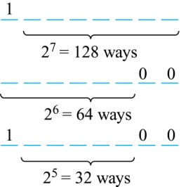
Counting Bit Strings
Example: How many bit strings of length eight either start with a 1 bit and end with the two bits 00?
Solution: Use the subtraction rule.
Number of bit strings of length eight that start with a 1 bit: 2⁷ = 128
Number of bit strings of length eight that start with bits 00: 2⁶ = 64
Number of bit strings of length eight that start with a 1 bit and end with bits 00 : 2⁵ = 32
Hence, the number is 128 + 64 − 32 = 160.

Slide 44
Basic Counting Principles: Division Rule
Division Rule: There are n/d ways to do a task if it can be done using a procedure that can be carried out in n ways, and for every way w, exactly d of the n ways correspond to way w.
Restated in terms of sets: If the finite set A is the union of n pairwise disjoint subsets each with d elements, then n = |A|/d.
In terms of functions: If f is a function from A to B, where both are finite sets, and for every value y ∈ B there are exactly d values x ∈ A such that f(x) = y, then |B| = |A|/d.

Slide 45
Basic Counting Principles: Division Rule
Example: How many ways are there to seat four people around a circular table, where two seating's are considered the same when each person has the same left and right neighbor?
Solution: Number the seats around the table from 1 to 4 proceeding clockwise. There are four ways to select the person for seat 1, 3 for seat 2, 2 for seat 3, and one way for seat 4. Thus there are 4! = 24 ways to order the four people. But since two seating's are the same when each person has the same left and right neighbor, for every choice for seat 1, we get the same seating.
Therefore, by the division rule, there are 24/4 = 6 different seating arrangements.

Slide 46
Tree Diagrams
Tree Diagrams: We can solve many counting problems through the use of tree diagrams, where a branch represents a possible choice and the leaves represent possible outcomes.
Example: Suppose that “I Love Discrete Math” T-shirts come in five different sizes: S,M,L,XL, and XXL. Each size comes in four colors (white, red, green, and black), except XL, which comes only in red, green, and black, and XXL, which comes only in green and black. What is the minimum number of stores that the campus book store needs to stock to have one of each size and color available?

Slide 47
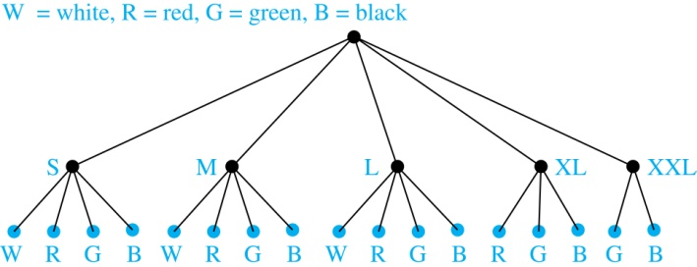
Tree Diagrams
Solution: Draw the tree diagram.
The store must stock 17 T-shirts.

Slide 48
The Pigeonhole Principle
Section 6.2

Slide 49
Section Summary
The Pigeonhole Principle
The Generalized Pigeonhole Principle

Slide 50
The Pigeonhole Principle
Pigeonhole Principle: If k is a positive integer and k + 1 objects are placed into k boxes, then at least one box contains two or more objects.
Proof: We use a proof by contraposition. Suppose none of the k boxes has more than one object. Then the total number of objects would be at most k. This contradicts the statement that we have k + 1 objects.

Slide 51
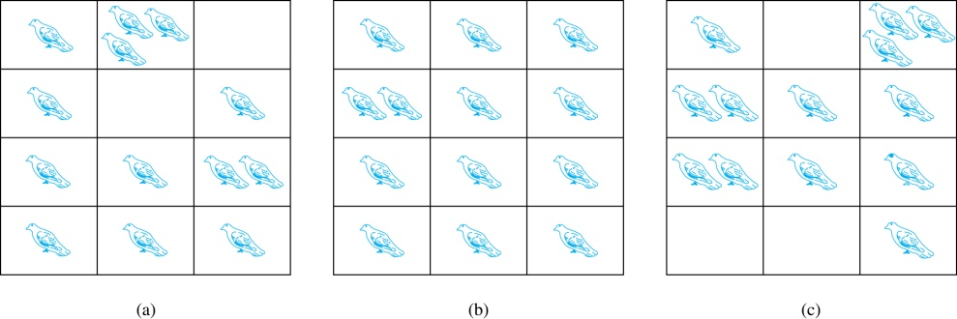
The Pigeonhole Principle
If a flock of 20 pigeons roosts in a set of 19 pigeonholes, one of the pigeonholes must have more than 1 pigeon.

Slide 52
The Pigeonhole Principle
Corollary 1: A function f from a set with k + 1 elements to a set with k elements is not one-to-one.
Proof: Use the pigeonhole principle.
Create a box for each element y in the codomain of f .
Put in the box for y all of the elements x from the domain such that f(x) = y.
Because there are k + 1 elements and only k boxes, at least one box has two or more elements.
Hence, f can’t be one-to-one.

Slide 53
Pigeonhole Principle
Example: Among any group of 367 people, there must be at least two with the same birthday, because there are only 366 possible birthdays. ⌈367/366⌉ = 2
Example: Among 100 people there are at least ⌈100/12⌉ = 9 who were born in the same month.
Example: In any set of 27 English , must be at least two that begin with the same letter, since there are 26 letters in the English alphabet. ⌈27/26⌉ = 2

Slide 54
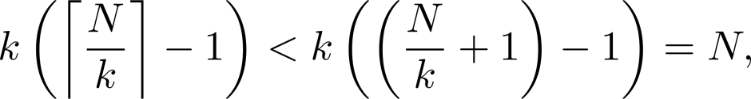
The Generalized Pigeonhole Principle
The Generalized Pigeonhole Principle: If N objects are placed into k boxes, then there is at least one box containing at least ⌈N/k⌉ objects.
Proof: We use a proof by contraposition. Suppose that none of the boxes contains more than ⌈N/k⌉ − 1 objects. Then the total number of objects is at most
where the inequality ⌈N/k⌉ < ⌈N/k⌉ + 1 has been used. This is a contradiction because there are a total of n objects.

Slide 55
The Generalized Pigeonhole Principle
Example: What is the minimum number of students required in a Discrete Mathematics class to be sure that at least six will receive the same grade, if there are five possible grades, A, B, C, D, and F.
Solution:
The minimum number of students needed to guarantee that at least six students receive the same grade is the smallest integer N such that ⌈ N/K ⌉ = ⌈ N/5 ⌉ = 6. The smallest such integer is
N = K(⌈ N/K ⌉-1)+1 = 5(6-1)+1=5 ⋅ 5 + 1 = 26.
Thus 26 is the minimum number of students needed to be sure that at least 6 students will receive the same grades.

Slide 56
Permutations and Combinations
Section 6.3

Slide 57
Section Summary
Permutations
Combinations
Combinatorial Proofs

Slide 58
Permutations
Definition: A permutation of a set of distinct objects is an ordered arrangement of these objects. An ordered arrangement of r elements of a set is called an r-permutation.
Example: Let S = {1,2,3}.
The ordered arrangement 3,1,2 is a permutation of S.
The ordered arrangement 3,2 is a 2-permutation of S.
The number of r-permutations of a set with n elements is denoted by P(n,r).
The 2-permutations of S = {1,2,3} are 1,2; 1,3; 2,1; 2,3; 3,1; and 3,2. Hence, P(3,2) = 6.

Slide 59
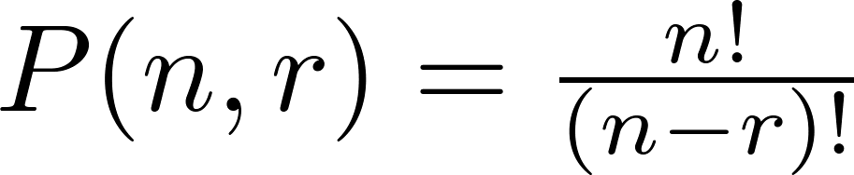
A Formula for the Number of Permutations
Theorem 1: If n is a positive integer and r is an integer with 1 ≤ r ≤ n, then there are
P(n, r) = n(n − 1)(n − 2) ∙∙∙ (n − r + 1)
r-permutations of a set with n distinct elements.
Proof: Use the product rule. The first element can be chosen in n ways. The second in n − 1 ways, and so on until there are (n − ( r − 1)) ways to choose the last element.
Note that P(n,0) = 1, since there is only one way to order zero elements.
Corollary 1: If n and r are integers with 1 ≤ r ≤ n, then

Slide 60
Solving Counting Problems by Counting Permutations
Example: How many ways are there to select a first-prize winner, a second prize winner, and a third-prize winner from 100 different people who have entered a contest?
Solution:
P(100,3) = 100 ∙ 99 ∙ 98 = 970,200

Slide 61
Solving Counting Problems by Counting Permutations (continued)
Example: Suppose that there are eight runners in a race. The winner receives a gold medal, the second place finisher receives a silver medal, and the third-place finisher receives a bronze medal. How many different ways are there to award these medals, if all possible outcomes of the race can occur and there are no ties?
Solution: The number of different ways to award the medals is the number of 3-permutations of a set with eight elements. Hence, there are P(8, 3) = 8 · 7 · 6 = 336 possible ways to award the medals.

Slide 62
Solving Counting Problems by Counting Permutations (continued)
Example: Suppose that a saleswoman has to visit eight different cities. She must begin her trip in a specified city, but she can visit the other seven cities in any order she wishes. How many possible orders can the saleswoman use when visiting these cities?
Solution: The first city is chosen, and the rest are ordered arbitrarily. Hence the orders are:
7! = 7 ∙ 6 ∙ 5 ∙ 4 ∙ 3 ∙ 2 ∙ 1 = 5040
If she wants to find the tour with the shortest path that visits all the cities, she must consider 5040 paths!

Slide 63
Solving Counting Problems by Counting Permutations (continued)
Example: How many permutations of the letters ABCDEFGH contain the string ABC ?
Solution: We solve this problem by counting the permutations of six objects, ABC, D, E, F, G, and H.
6! = 6 ∙ 5 ∙ 4 ∙ 3 ∙ 2 ∙ 1 = 720

Slide 64
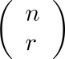
Combinations
Definition: An r-combination of elements of a set is an unordered selection of r elements from the set. Thus, an r-combination is simply a subset of the set with r elements.
The number of r-combinations of a set with n distinct elements is denoted by C(n, r).
The notation is also used and is called a binomial coefficient. (We will see the notation again in the binomial theorem in Section. 6.4)

Slide 65
Combinations
Example:
Let S be the set {a, b, c, d}. Then {a, c, d} is a 3-combination from S. It is the same as {d, c, a} since the order listed does not matter.
C(4,2) = 6 because the 2-combinations of {a, b, c, d} are the six subsets {a, b}, {a, c}, {a, d}, {b, c}, {b, d}, and {c, d}.

Slide 66
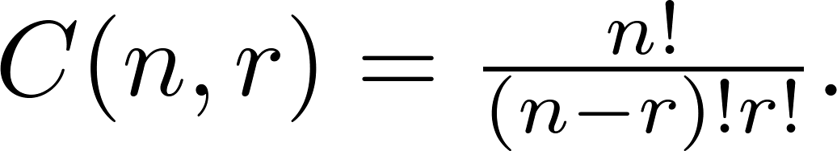

Combinations
Theorem 2: The number of r-combinations of a set with n elements, where n ≥ r ≥ 0, equals
Proof: By the product rule P(n, r) = C(n,r) ∙ P(r,r). Therefore,

Slide 67
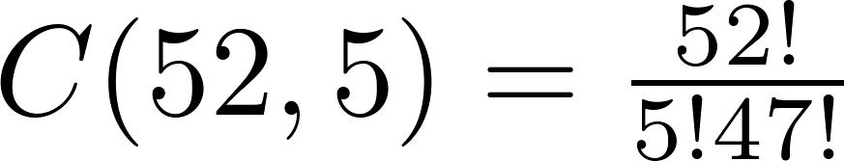


Combinations
Example: How many poker hands of five cards can be dealt from a standard deck of 52 cards? Also, how many ways are there to select 47 cards from a deck of 52 cards?
Solution: Since the order in which the cards are dealt does not matter, the number of five card hands is:
The different ways to select 47 cards from 52 is
This is a special case of a general result. →

Slide 68
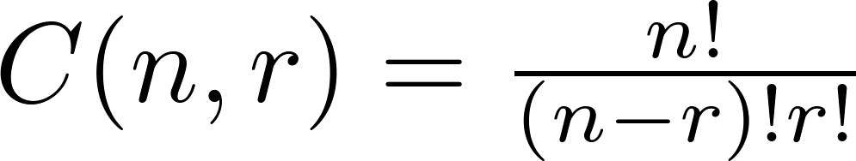

Combinations
Corollary 2: Let n and r be nonnegative integers with r ≤ n. Then C(n, r) = C(n, n − r).
Proof: From Theorem 2, it follows that
and
Hence, C(n, r) = C(n, n − r).
This result can be proved without using algebraic manipulation. →

Slide 69
Combinatorial Proofs
Definition 1: A combinatorial proof of an identity is a proof that uses one of the following methods.
A double counting proof uses counting arguments to prove that both sides of an identity count the same objects, but in different ways.
A bijective proof shows that there is a bijection between the sets of objects counted by the two sides of the identity.

Slide 70

Combinatorial Proofs
Here are two combinatorial proofs that
C(n, r) = C(n, n − r)
when r and n are nonnegative integers with r < n:
Bijective Proof: Suppose that S is a set with n elements. The function that maps a subset A of S to is a bijection between the subsets of S with r elements and the subsets with n − r elements. Since there is a bijection between the two sets, they must have the same number of elements.
Double Counting Proof: By definition the number of subsets of S with r elements is C(n, r). Each subset A of S can also be described by specifying which elements are not in A, i.e., those which are in . Since the complement of a subset of S with r elements has n − r elements, there are also C(n, n − r) subsets of S with r elements.

Slide 71
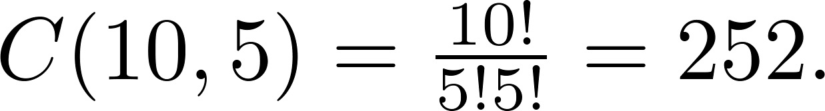

Combinations
Example: How many ways are there to select five players from a 10-member tennis team to make a trip to a match at another school.
Solution: By Theorem 2, the number of combinations is
Example: A group of 30 people have been trained as astronauts to go on the first mission to Mars. How many ways are there to select a crew of six people to go on this mission?
Solution: By Theorem 2, the number of possible crews is

Slide 72
Binomial Coefficients and Identities
Section 6.4

Slide 73
Section Summary
The Binomial Theorem
Pascal’s Identity and Triangle

Slide 74

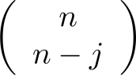
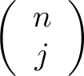
Binomial Theorem
Binomial Theorem: Let x and y be variables, and n a nonnegative integer. Then:
Proof: We use combinatorial reasoning . The terms in the expansion of (x + y)^{n} are of the form x^{n−j}y^{j} for j = 0,1,2,…,n. To form the term x^{n−j}y^{j}, it is necessary to choose n−j xs from the n sums. Therefore, the coefficient of x^{n−j}y^{j} is which equals .

Slide 75
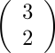
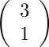
Powers of Binomial Expressions
Definition: A binomial expression is the sum of two terms, such as x + y. (More generally, these terms can be products of constants and variables.)
We can use counting principles to find the coefficients in the expansion of (x + y)^{n} where n is a positive integer.
To illustrate this idea, we first look at the process of expanding (x + y)³.
(x + y) (x + y) (x + y) expands into a sum of terms that are the product of a term from each of the three sums.
Terms of the form x³, x²y, x y², y³ arise. The question is what are the coefficients?
To obtain x³ , an x must be chosen from each of the sums. There is only one way to do this. So, the coefficient of x³ is 1.
To obtain x²y, an x must be chosen from two of the sums and a y from the other. There are ways to do this and so the coefficient of x²y is 3.
To obtain xy², an x must be chosen from of the sums and a y from the other two . There are ways to do this and so the coefficient of xy² is 3.
To obtain y³ , a y must be chosen from each of the sums. There is only one way to do this. So, the coefficient of y³ is 1.
We have used a counting argument to show that (x + y)³ = x³ + 3x²y + 3x y² + y³ .
Next we present the binomial theorem gives the coefficients of the terms in the expansion of (x + y)^{n} .

Slide 76
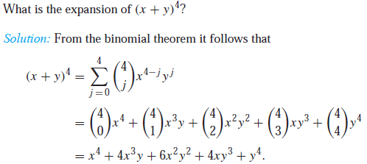
Using the Binomial Theorem
Example:

Slide 77
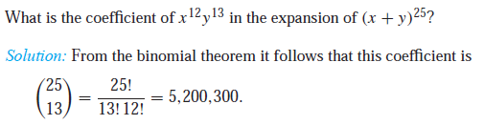
Using the Binomial Theorem

Slide 78
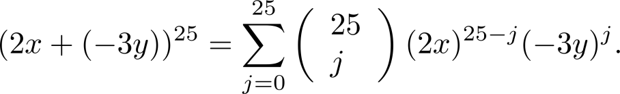
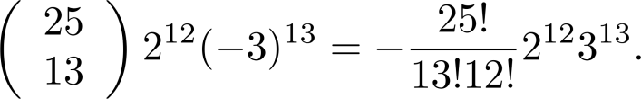
Using the Binomial Theorem
Example: What is the coefficient of x¹²y¹³ in the expansion of (2x − 3y)²⁵?
Solution: We view the expression as (2x +(−3y))²⁵. By the binomial theorem
Consequently, the coefficient of x¹²y¹³ in the expansion is obtained when j = 13.

Slide 79
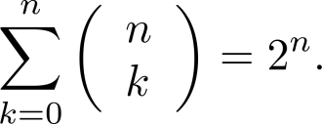
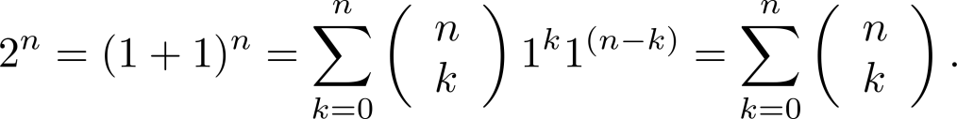
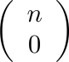
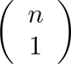
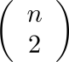
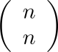
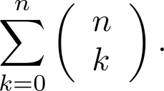
A Useful Identity
Corollary 1: With n ≥0,
Proof (using binomial theorem): With x = 1 and y = 1, from the binomial theorem we see that:
Proof (combinatorial): Consider the subsets of a set with n elements. There are subsets with zero elements, with one element, with two elements, …, and with n elements. Therefore the total is
Since, we know that a set with n elements has 2^{n} subsets, we conclude:

Slide 80
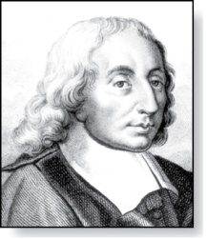
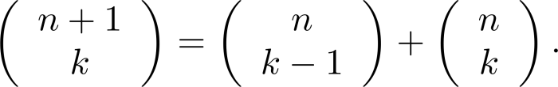
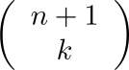
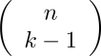
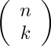
Pascal’s Identity
Blaise Pascal
(1623-1662)
Pascal’s Identity: If n and k are integers with n ≥ k ≥ 0, then
Proof (combinatorial): Let T be a set where |T| = n + 1, a ∊T, and S = T − {a}. There are subsets of T containing k elements. Each of these subsets either:
contains a with k − 1 other elements, or
contains k elements of S and not a.
There are
subsets of k elements that contain a, since there are subsets of k − 1 elements of S,
subsets of k elements of T that do not contain a, because there are subsets of k elements of S.
Hence,
See Exercise 19 for an algebraic proof.

Slide 81
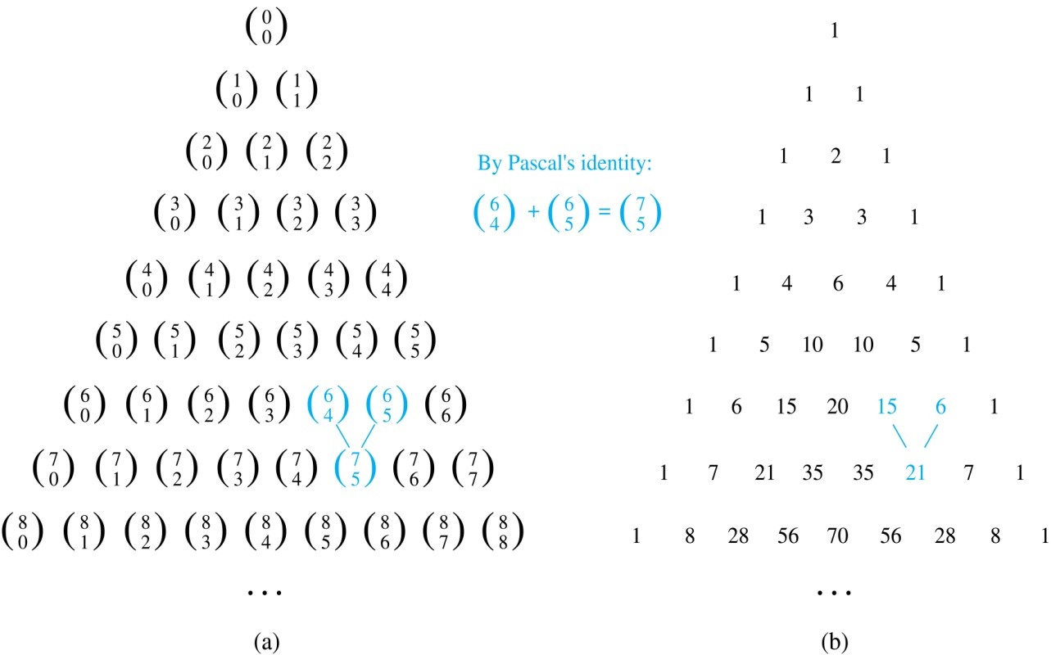
Pascal’s Triangle
The nth row in the triangle consists of the binomial coefficients ,
k = 0,1,….,n.
By Pascal’s identity, adding two adjacent bionomial coefficients results is the binomial coefficient in the next row between these two coefficients.

Slide 82
Graphs
Chapter 10

Slide 83
Chapter Summary
Graphs and Graph Models
Graph Terminology and Special Types of Graphs
Representing Graphs and Graph Isomorphism
Connectivity
Euler and Hamiltonian Graphs
Shortest-Path Problems
Planar Graphs
Graph Coloring

Slide 84
Graphs and Graph Models
Section 10.1

Slide 85
Section Summary
Introduction to Graphs
Graph Taxonomy
Graph Models

Slide 86
Graphs
Definition: A graph G = (V, E) consists of a nonempty set V of vertices (or nodes) and a set E of edges. Each edge has either one or two vertices associated with it, called its endpoints. An edge is said to connect its endpoints.
Remarks:
The graphs we study here are unrelated to graphs of functions studied in Chapter 2.
We have a lot of freedom when we draw a picture of a graph. All that matters is the connections made by the edges, not the particular geometry depicted. For example, the lengths of edges, whether edges cross, how vertices are depicted, and so on, do not matter
A graph with an infinite vertex set is called an infinite graph. A graph with a finite vertex set is called a finite graph. We (following the text) restrict our attention to finite graphs.
Example:
a
b
This is a graph with four vertices and five edges.
d
c

Slide 87
Some Terminology
In a simple graph each edge connects two different vertices and no two edges connect the same pair of vertices.
Multigraphs may have multiple edges connecting the same two vertices. When m different edges connect the vertices u and v, we say that {u,v} is an edge of multiplicity m.
An edge that connects a vertex to itself is called a loop.
A pseudograph may include loops, as well as multiple edges connecting the same pair of vertices.
Example:
This pseudograph has both multiple edges and a loop.
a
b
Remark: There is no standard terminology for graph theory. So, it is crucial that you understand the terminology being used whenever you read material about graphs.
c

Slide 88
Directed Graphs
Definition: An directed graph (or digraph) G = (V, E) consists of a nonempty set V of vertices (or nodes) and a set E of directed edges (or arcs). Each edge is associated with an ordered pair of vertices. The directed edge associated with the ordered pair (u,v) is said to start at u and end at v.
Remark:
Graphs where the end points of an edge are not ordered are said to be undirected graphs.

Slide 89
Some Terminology (continued)
A simple directed graph has no loops and no multiple edges.
A directed multigraph may have multiple directed edges. When there are m directed edges from the vertex u to the vertex v, we say that (u,v) is an edge of multiplicity m.
Example:
a
b
This is a directed graph with three vertices and four edges.
c
Example:
In this directed multigraph the multiplicity of (a,b) is 1 and the multiplicity of (b,c) is 2.
a
b
c

Slide 90
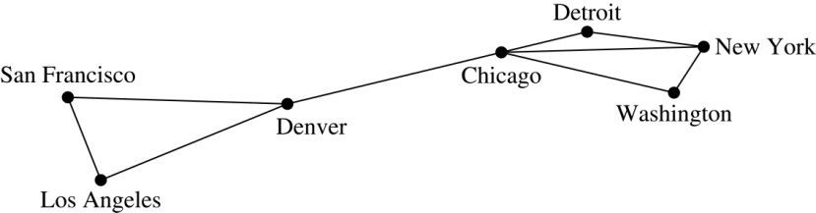
Graph Models: Computer Networks
When we build a graph model, we use the appropriate type of graph to capture the important features of the application.
We illustrate this process using graph models of different types of computer networks. In all these graph models, the vertices represent data centers and the edges represent communication links.
To model a computer network where we are only concerned whether two data centers are connected by a communications link, we use a simple graph. This is the appropriate type of graph when we only care whether two data centers are directly linked (and not how many links there may be) and all communications links work in both directions.

Slide 91
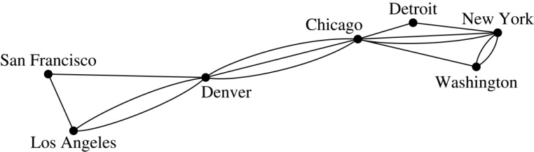
Graph Models: Computer Networks (continued)
To model a computer network where we care about the number of links between data centers, we use a multigraph.

Slide 92
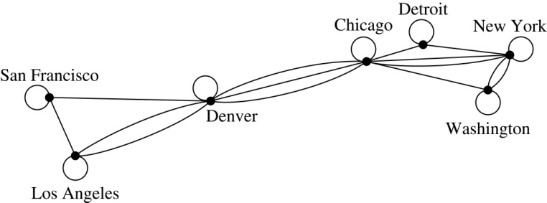
Graph Models: Computer Networks
To model a computer network with diagnostic links at data centers, we use a pseudograph, as loops are needed.

Slide 93
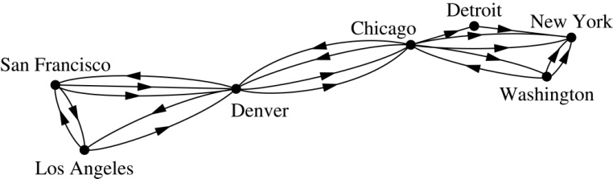
Graph Models: Computer Networks
To model a network with multiple one-way links, we use a directed multigraph. Note that we could use a directed graph without multiple edges if we only care whether there is at least one link from a data center to another data center.

Slide 94
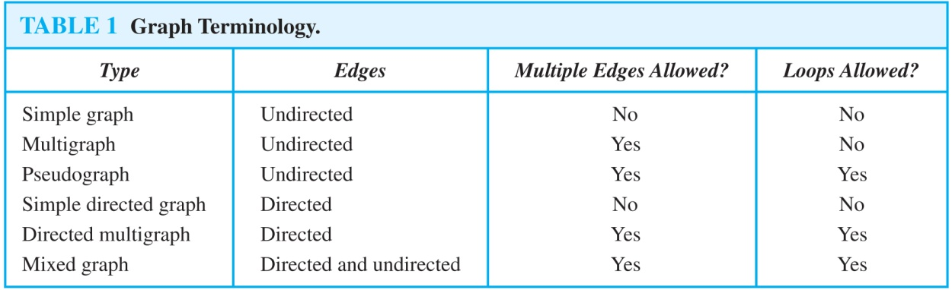
Graph Terminology: Summary
To understand the structure of a graph and to build a graph model, we ask these questions:
Are the edges of the graph undirected or directed (or both)?
If the edges are undirected, are multiple edges present that connect the same pair of vertices? If the edges are directed, are multiple directed edges present?
Are loops present?

Slide 95
Other Applications of Graphs
We will illustrate how graph theory can be used in models of:
Social networks
Communications networks
Information networks
Software design
Transportation networks
Biological networks
It’s a challenge to find a subject to which graph theory has not yet been applied. Can you find an area without applications of graph theory?

Slide 96
Graph Models: Social Networks
Graphs can be used to model social structures based on different kinds of relationships between people or groups.
In a social network, vertices represent individuals or organizations and edges represent relationships between them.
Useful graph models of social networks include:
friendship graphs - undirected graphs where two people are connected if they are friends (in the real world, on Facebook, or in a particular virtual world, and so on.)
collaboration graphs - undirected graphs where two people are connected if they collaborate in a specific way
influence graphs - directed graphs where there is an edge from one person to another if the first person can influence the second person..

Slide 97
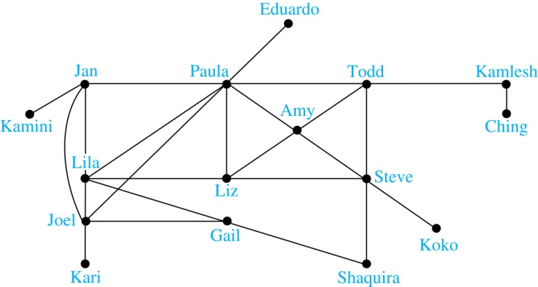
Graph Models: Social Networks
Example: A friendship graph where two people are connected if they are Facebook friends.

Slide 98
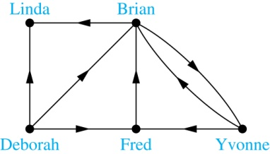
Graph Models: Social Networks
Example: An influence graph

Slide 99
Applications to Information Networks
Graphs can be used to model different types of networks that link different types of information.
In a web graph, web pages are represented by vertices and links are represented by directed edges.
A web graph models the web at a particular time.
We will explain how the web graph is used by search engines in Section 11.4.
In a citation network:
Research papers in a particular discipline are represented by vertices.
When a paper cites a second paper as a reference, there is an edge from the vertex representing this paper to the vertex representing the second paper.

Slide 100
Transportation Graphs
Graph models are extensively used in the study of transportation networks.
Airline networks can be modeled using directed multigraphs where
airports are represented by vertices
each flight is represented by a directed edge from the vertex representing the departure airport to the vertex representing the destination airport
Road networks can be modeled using graphs where
vertices represent intersections and edges represent roads.
undirected edges represent two-way roads and directed edges represent one-way roads.

Slide 101
Software Design Applications
Graph models are extensively used in software design. We will introduce two such models here; one representing the dependency between the modules of a software application and the other representing restrictions in the execution of statements in computer programs.
When a top-down approach is used to design software, the system is divided into modules, each performing a specific task.
We use a module dependency graph to represent the dependency between these modules. These dependencies need to be understood before coding can be done.

Slide 102

Software Design Applications
In a module dependency graph vertices represent software modules and there is an edge from one module to another if the second module depends on the first.
Example: The dependencies between the seven modules in the design of a web browser are represented by this module dependency graph.

Slide 103

Software Design Applications
We can use a directed graph called a precedence graph to represent which statements must have already been executed before we execute each statement.
Vertices represent statements in a computer program
There is a directed edge from a vertex to a second vertex if the second vertex cannot be executed before the first
Example: This precedence graph shows which statements must already have been executed before we can execute each of the six statements in the program.

Slide 104

Biological Applications
Graph models are used extensively in many areas of the biological science. We will describe two such models, one to ecology and the other to molecular biology.
Niche overlap graphs model competition between species in an ecosystem
Vertices represent species and an edge connects two vertices when they represent species who compete for food resources.
Example: This is the niche overlap graph for a forest ecosystem with nine species.

Slide 105
Biological Applications
We can model the interaction of proteins in a cell using a protein interaction network.
In a protein interaction graph, vertices represent proteins and vertices are connected by an edge if the proteins they represent interact.
Protein interaction graphs can be huge and can contain more than 100,000 vertices, each representing a different protein, and more than 1,000,000 edges, each representing an interaction between proteins
Protein interaction graphs are often split into smaller graphs, called modules, which represent the interactions between proteins involved in a particular function.

Slide 106

Biological Applications
Example: This is a module of the protein interaction graph of
proteins that degrade RNA in a human cell.

Slide 107
Graph Terminology and Special Types of Graphs
Section 10.2

Slide 108
Section Summary
Basic Terminology
Some Special Types of Graphs
Bipartite Graphs
Bipartite Graphs and Matchings
Some Applications of Special Types of Graphs
New Graphs from Old

Slide 109

Basic Terminology
Definition 1. Two vertices u, v in an undirected graph G are called adjacent (or neighbors) in G if there is an edge e between u and v. Such an edge e is called incident with the vertices u and v and e is said to connect u and v.
Definition 2. The set of all neighbors of a vertex v of G = (V, E), denoted by N(v), is called the neighborhood of v. If A is a subset of V, we denote by N(A) the set of all vertices in G that are adjacent to at least one vertex in A. So,
Definition 3. The degree of a vertex in a undirected graph is the number of edges incident with it, except that a loop at a vertex contributes two to the degree of that vertex. The degree of the vertex v is denoted by deg(v).

Slide 110

Degrees and Neighborhoods of Vertices
Example: What are the degrees and neighborhoods of the vertices in the graphs G and H?
Solution:
G: deg(a) = 2, deg(b) = deg(c) = deg(f ) = 4, deg(d ) = 1, deg(e) = 3, deg(g) = 0.
N(a) = {b, f }, N(b) = {a, c, e, f }, N(c) = {b, d, e, f }, N(d) = {c},
N(e) = {b, c , f }, N(f) = {a, b, c, e}, N(g) = ∅ .
H: deg(a) = 4, deg(b) = deg(e) = 6, deg(c) = 1, deg(d) = 5.
N(a) = {b, d, e}, N(b) = {a, b, c, d, e}, N(c) = {b}, N(d) = {a, b, e},
N(e) = {a, b ,d}.

Slide 111
Handshaking Theorem
Theorem: If G is any graph, then the sum of the degrees of all the vertices of G equals twice the number of edges of G.
Specifically, if the vertices of G are v1, v2, …, vn, where n is a positive integer, then
the total degree of G = deg(v1) + deg(v2) + … + deg(vn) = 2 . (the number of edges of G)
PROOF:
Each edge “e” of G connects its end points vi and vj. This edge, therefore contributes 1 to the degree of vi and 1 to the degree of vj.
If “e” is a loop, then it is counted twice in computing the degree of the vertex on which it is incident.
Accordingly, each edge of G contributes 2 to the total degree of G.
Thus, the total degree of G = 2. (the number of edges of G)
COROLLARY: The total degree of G is an even number

Slide 112

Degree of Vertices
Theorem: An undirected graph has an even number of vertices of odd degree.
Proof: Let V₁ be the vertices of even degree and V₂ be the vertices of odd degree in an undirected graph G = (V, E) with m edges. Then
even
must be even since deg(v) is even for each v ∈ V₁
This sum must be even because 2m is even and the sum of the degrees of the vertices of even degrees is also even. Because this is the sum of the degrees of all vertices of odd degree in the graph, there must be an even number of such vertices.

Slide 113
Handshaking Theorem
We now give two examples illustrating the usefulness of the handshaking theorem.
Example: How many edges are there in a graph with 10 vertices of degree six?
Solution: Because the sum of the degrees of the vertices is 6 ⋅ 10 = 60, the handshaking theorem tells us that 2m = 60. So the number of edges m = 30.
Example: If a graph has 5 vertices, can each vertex have degree 3?
Solution: This is not possible by the handshaking thoerem, because the sum of the degrees of the vertices 3 ⋅ 5 = 15 is odd.

Slide 114
Directed Graphs
Recall the definition of a directed graph.
Definition: An directed graph G = (V, E) consists of V, a nonempty set of vertices (or nodes), and E, a set of directed edges or arcs. Each edge is an ordered pair of vertices. The directed edge (u,v) is said to start at u and end at v.
Definition: Let (u,v) be an edge in G. Then u is the initial vertex of this edge and is adjacent to v and v is the terminal (or end) vertex of this edge and is adjacent from u. The initial and terminal vertices of a loop are the same.

Slide 115

Directed Graphs (continued)
Definition: The in-degree of a vertex v, denoted deg⁻(v), is the number of edges which terminate at v. The out-degree of v, denoted deg⁺(v), is the number of edges with v as their initial vertex. Note that a loop at a vertex contributes 1 to both the in-degree and the out-degree of the vertex.
Example: In the graph G we have
deg⁻(a) = 2, deg⁻(b) = 2, deg⁻(c) = 3, deg⁻(d) = 2, deg⁻(e) = 3, deg⁻(f) = 0.
deg⁺(a) = 4, deg⁺(b) = 1, deg⁺(c) = 2, deg⁺(d) = 2, deg⁺ (e) = 3, deg⁺(f) = 0.

Slide 116

Directed Graphs (continued)
Theorem 3: Let G = (V, E) be a graph with directed edges. Then:
Proof: The first sum counts the number of outgoing edges over all vertices and the second sum counts the number of incoming edges over all vertices. It follows that both sums equal the number of edges in the graph.

Slide 117

Special Types of Simple Graphs: Complete Graphs
A complete graph on n vertices, denoted by K_{n}, is the simple graph that contains exactly one edge between each pair of distinct vertices.

Slide 118


Special Types of Simple Graphs: Cycles and Wheels
A cycle C_{n} for n ≥ 3 consists of n vertices v₁, v₂ ,⋯ , v_{n}, and edges {v₁, v₂}, {v₂, v₃} ,⋯ , {v_{n-1}, v_{n}}, {v_{n}, v₁}.
A wheel W_{n} is obtained by adding an additional vertex to a cycle C_{n} for n ≥ 3 and connecting this new vertex to each of the n vertices in C_{n} by new edges.

Slide 119

Special Types of Simple Graphs: n-Cubes
An n-dimensional hypercube, or n-cube, Q_{n}, is a graph with 2^{n} vertices representing all bit strings of length n, where there is an edge between two vertices that differ in exactly one bit position.

Slide 120

Special Types of Graphs and Computer Network Architecture
Various special graphs play an important role in the design of computer networks.
Some local area networks use a star topology, which is a complete bipartite graph K_{1,n} ,as shown in (a). All devices are connected to a central control device.
Other local networks are based on a ring topology, where each device is connected to exactly two others using C_{n} ,as illustrated in (b). Messages may be sent around the ring.
Others, as illustrated in (c), use a W_{n} – based topology, combining the features of a star topology and a ring topology.

Slide 121

Special Types of Graphs and Computer Network Architecture
Various special graphs also play a role in parallel processing where processors need to be interconnected as one processor may need the output generated by another.
The n-dimensional hypercube, or n-cube, Qn, is a common way to connect processors in parallel, e.g., Intel Hypercube.
Another common method is the mesh network, illustrated here for 16 processors.

Slide 122

Bipartite Graphs
Definition: A simple graph G is bipartite if V can be partitioned into two disjoint subsets V₁ and V₂ such that every edge connects a vertex in V₁ and a vertex in V₂. In other words, there are no edges which connect two vertices in V₁ or in V₂.
It is not hard to show that an equivalent definition of a bipartite graph is a graph where it is possible to color the vertices red or blue so that no two adjacent vertices are the same color.
H is not bipartite since if we color a red, then the adjacent vertices f and b must both be blue.
G is bipartite

Slide 123

Bipartite Graphs (continued)
Example: Show that C₆ is bipartite.
Solution: We can partition the vertex set into
V₁ = {v₁, v₃, v₅} and V₂ = {v₂, v₄, v₆} so that every edge of C₆ connects a vertex in V₁ and V₂ .

Slide 124

Bipartite Graphs (continued)
Example: Show that C₃ is not bipartite.
Solution: If we divide the vertex set of C₃ into two nonempty sets, one of the two must contain two vertices. But in C₃ every vertex is connected to every other vertex. Therefore, the two vertices in the same partition are connected. Hence, C₃ is not bipartite.

Slide 125

Bipartite Graphs and Matchings
Bipartite graphs are used to model applications that involve matching the elements of one set to elements in another, for example:
Job assignments - vertices represent the jobs and the employees, edges link employees with those jobs they have been trained to do. A common goal is to match jobs to employees so that the most jobs are done.

Slide 126

Complete Bipartite Graphs
Definition: A complete bipartite graph K_{m,n} is a graph that has its vertex set partitioned into two subsets V₁ of size m and V₂ of size n such that there is an edge from every vertex in V₁ to every vertex in V₂.
Example: We display four complete bipartite graphs here.

Slide 127

New Graphs from Old
Definition: A subgraph of a graph G = (V,E) is a graph (W,F), where W ⊂ V and F ⊂ E. A subgraph H of G is a proper subgraph of G if H ≠ G.
Example: Here we show K₅ and one of its subgraphs.
Definition: Let G = (V, E) be a simple graph. The subgraph induced by a subset W of the vertex set V is the graph (W,F), where the edge set F contains an edge in E if and only if both endpoints are in W.
Example: Here we show K₅ and the subgraph induced by W = {a,b,c,e}.

Slide 128

New Graphs from Old (continued)
Definition: The union of two simple graphs G₁ = (V₁, E₁) and G₂ = (V₂, E₂) is the simple graph with vertex set V₁ ⋃ V₂ and edge set E₁ ⋃ E₂. The union of G₁ and G₂ is denoted by G₁ ⋃ G₂.
Example:

Slide 129
Representing Graphs and Graph Isomorphism
Section 10.3

Slide 130
Section Summary
Adjacency Lists
Adjacency Matrices
Incidence Matrices
Isomorphism of Graphs

Slide 131


Representing Graphs: Adjacency Lists
Definition: An adjacency list can be used to represent a graph with no multiple edges by specifying the vertices that are adjacent to each vertex of the graph.
Example:

Slide 132


Representing Graphs: Adjacency Lists
Example:

Slide 133

Representation of Graphs: Adjacency Matrices
Definition: Suppose that G = (V, E) is a simple graph where |V| = n. Arbitrarily list the vertices of G as v₁, v₂, … , v_{n}. The adjacency matrix A_{G} of G, with respect to the listing of vertices, is the n × n zero-one matrix with 1 as its (i, j)th entry when v_{i} and v_{j} are adjacent, and 0 as its (i, j)th entry when they are not adjacent.
In other words, if the graphs adjacency matrix is A_{G} = [a_{ij}], then

Slide 134




Adjacency Matrices (continued)
Example:
When a graph is sparse, that is, it has few edges relatively to the total number of possible edges, it is much more efficient to represent the graph using an adjacency list than an adjacency matrix. But for a dense graph, which includes a high percentage of possible edges, an adjacency matrix is preferable.
The ordering
of vertices is a, b, c, d.
The ordering of vertices is a, b, c, d.
Note: The adjacency matrix of a simple graph is symmetric, i.e., a_{ij} = a_{ji}
Also, since there are no loops, each diagonal entry a_{ij} for i = 1, 2, 3, …, n, is 0.

Slide 135

Adjacency Matrices (continued)
Adjacency matrices can also be used to represent graphs with loops and multiple edges.
A loop at the vertex vi is represented by a 1 at the (i, j)th position of the matrix.
When multiple edges connect the same pair of vertices vi and vj, (or if multiple loops are present at the same vertex), the (i, j)th entry equals the number of edges connecting the pair of vertices.
Example: We give the adjacency matrix of the pseudograph shown here using the ordering of vertices a, b, c, d.

Slide 136
Adjacency Matrices (continued)
Adjacency matrices can also be used to represent directed graphs. The matrix for a directed graph G = (V, E) has a 1 in its (i, j)th position if there is an edge from v_{i} to v_{j}, where v₁, v₂, … v_{n} is a list of the vertices.
In other words, if the graphs adjacency matrix is A_{G} = [a_{ij}], then
The adjacency matrix for a directed graph does not have to be symmetric, because there may not be an edge from v_{i} to v_{j}, when there is an edge from v_{j} to v_{i}.
To represent directed multigraphs, the value of a_{ij} is the number of edges connecting v_{i} to v_{j}.

Slide 137

Representation of Graphs: Incidence Matrices
Definition: Let G = (V, E) be an undirected graph with vertices where v₁, v₂, … v_{n} and edges e₁, e₂, … e_{m}. The incidence matrix with respect to the ordering of V and E is the n × m matrix M = [m_{ij}], where

Slide 138




Incidence Matrices (continued)
Example: Simple Graph and Incidence Matrix
The rows going from top to bottom represent v₁ through v₅ and the columns going from left to right represent e₁ through e₆.
Example: Pseudograph and Incidence Matrix
The rows going from top to bottom represent v₁ through v₅ and the columns going from left to right represent e₁ through e₈.

Slide 139
Isomorphism of Graphs
Definition: The simple graphs G₁ = (V₁, E₁) and G₂ = (V₂, E₂) are isomorphic if there is a one-to-one and onto function f from V₁ to V₂ with the property that a and b are adjacent in G₁ if and only if f(a) and f(b) are adjacent in G₂ , for all a and b in V₁ . Such a function f is called an isomorphism. Two simple graphs that are not isomorphic are called nonisomorphic.

Slide 140
ISOMORPHIC INVARIANT
A property P is called an isomorphic invariant if, and only if, given any graphs G and G’,
If G has property P and G’ is isomorphic to G, then G’ has property P.
THEOREM OF ISOMORPHIC INVARIANT
Each of the following properties is an invariant for graph isomorphism, where n, m and k are all non-negative integers, if the graph:
1. has n vertices.
2. has m edges.
3. has a vertex of degree k.
4. has m vertices of degree k.
5. has a circuit of length k.
6. has a simple circuit of length k.
7. has m simple circuits of length k.
8. is connected.
9. has an Euler circuit.
10. has a Hamiltonian circuit.

Slide 141

Isomorphism of Graphs (cont.)
Example: Show that the graphs G =(V, E) and H = (W, F) are isomorphic.
Solution: The function f with
f(u₁) = v₁,f(u₂) = v₄, f(u₃) = v₃, and f(u₄) = v₂ is a one-to-one
correspondence between V and W.
Note that adjacent vertices in G are
u₁ and u₂, u₁ and u₃, u₂ and u₄,
and u₃ and u₄. Each of the pairs
f(u₁) = v₁ and f(u₂) = v₄, f(u₁) = v₁
and f(u₃) = v₃ , f(u₂) = v₄ and
f(u₄) = v₂ , and f(u₃) = v₃ and
f(u₄) = v₂ consists of two adjacent vertices in H.

Slide 142
Isomorphism of Graphs (cont.)
It is difficult to determine whether two simple graphs are isomorphic using brute force because there are n! possible one-to-one correspondences between the vertex sets of two simple graphs with n vertices.
The best algorithms for determining weather two graphs are isomorphic have exponential worst case complexity in terms of the number of vertices of the graphs.
Sometimes it is not hard to show that two graphs are not isomorphic. We can do so by finding a property, preserved by isomorphism, that only one of the two graphs has. Such a property is called graph invariant.
There are many different useful graph invariants that can be used to distinguish nonisomorphic graphs, such as the number of vertices, number of edges, and degree sequence (list of the degrees of the vertices in nonincreasing order). We will encounter others in later sections of this chapter.

Slide 143


Isomorphism of Graphs (cont.)
Example: Determine whether these two graphs are isomorphic.
Solution: Both graphs have eight vertices and ten edges.
They also both have four vertices of degree two and four of degree three.
However, G and H are not isomorphic. Note that since deg(a) = 2 in G, a must correspond to t, u, x, or y in H, because these are the vertices of degree 2. But each of these vertices is adjacent to another vertex of degree two in H, which is not true for a in G.
Alternatively, note that the subgraphs of G and H
made up of vertices of degree three and the edges
connecting them must be isomorphic.
But the subgraphs, as shown at the right,
are not isomorphic.

Slide 144

Isomorphism of Graphs (cont.)
Example: Determine whether these two graphs are isomorphic.
Solution: Both graphs have six vertices and seven edges.
They also both have four vertices of degree two and two of degree three.
The subgraphs of G and H consisting of all the vertices of degree two and the edges connecting them are isomorphic. So, it is reasonable to try to find an isomorphism f.
We define an injection f from the vertices of G to the vertices of H that preserves the degree of vertices. We will determine whether it is an isomorphism.
The function f with f(u₁) = v₆, f(u₂) = v₃, f(u₃) = v₄, and f(u₄) = v₅ , f(u₅) = v₁, and f(u₆) = v₂ is a one-to-one correspondence between G and H. Showing that this correspondence preserves edges is straightforward, so we will omit the details here. Because f is an isomorphism, it follows that G and H are isomorphic graphs.

Slide 145
Algorithms for Graph Isomorphism
The best algorithms known for determining whether two graphs are isomorphic have exponential worst-case time complexity (in the number of vertices of the graphs).
However, there are algorithms with linear average-case time complexity.
You can use a public domain program called NAUTY to determine in less than a second whether two graphs with as many as 100 vertices are isomoprhic.
Graph isomorphism is a problem of special interest because it is one of a few NP problems not known to be either tractable or NP-complete (see Section 3.3).

Slide 146
Applications of Graph Isomorphism
The question whether graphs are isomorphic plays an important role in applications of graph theory. For example,
chemists use molecular graphs to model chemical compounds. Vertices represent atoms and edges represent chemical bonds. When a new compound is synthesized, a database of molecular graphs is checked to determine whether the graph representing the new compound is isomorphic to the graph of a compound that this already known.
Electronic circuits are modeled as graphs in which the vertices represent components and the edges represent connections between them. Graph isomorphism is the basis for
the verification that a particular layout of a circuit corresponds to the design’s original schematics.
determining whether a chip from one vendor includes the intellectual property of another vendor.

Slide 147
Connectivity
Section 10.4

Slide 148
Section Summary
Paths
Connectedness in Undirected Graphs
Connectedness in Directed Graphs
Counting Paths between Vertices

Slide 149
Paths
Informal Definition: A path is a sequence of edges that begins at a vertex of a graph and travels from vertex to vertex along edges of the graph. As the path travels along its edges, it visits the vertices along this path, that is, the endpoints of these.
Applications: Numerous problems can be modeled with paths formed by traveling along edges of graphs such as:
determining whether a message can be sent between two computers.
efficiently planning routes for mail delivery.

Slide 150
Paths
Definition: Let n be a nonnegative integer and G an undirected graph. A path of length n from u to v in G is a sequence of n edges e₁, … , e_{n} of G for which there exists a sequence x₀ = u, x₁, …, x_{n-1}, x_{n} = v of vertices such that e_{i} has, for i = 1, …, n, the endpoints x_{i-1} and x_{i}.
When the graph is simple, we denote this path by its vertex sequence x₀, x₁, … , x_{n}(since listing the vertices uniquely determines the path).
The path is a circuit if it begins and ends at the same vertex (u = v) and has length greater than zero.
The path or circuit is said to pass through the vertices x₁, x₂, … , x_{n-1} and traverse the edges e₁, … , e_{n}.
A path or circuit is simple if it does not contain the same edge more than once.
This terminology is readily extended to directed graphs. (see text)

Slide 151

Paths (continued)
Example: In the simple graph here:
a, d, c, f, e is a simple path of length 4.
d, e, c, a is not a path because e is not connected to c.
b, c, f, e, b is a circuit of length 4.
a, b, e, d, a, b is a path of length 5, but it is not a simple path.

Slide 152

Connectedness in Undirected Graphs
Definition: An undirected graph is called connected if there is a path between every pair of vertices. An undirected graph that is not connected is called disconnected. We say that we disconnect a graph when we remove vertices or edges, or both, to produce a disconnected subgraph.
Example: G₁ is connected because there is a path between any pair of its vertices, as can be easily seen. However G₂ is not connected because there is no path between vertices a and f, for example.

Slide 153
Euler and Hamiltonian Graphs
Section 10.5

Slide 154
Section Summary
Euler Paths and Circuits
Hamilton Paths and Circuits
Applications of Hamilton Circuits

Slide 155



Euler Paths and Circuits
The town of Kӧnigsberg, Prussia
(now Kalingrad, Russia) was divided into
four sections by the branches of the Pregel river. In the 18th century seven bridges connected these regions.
People wondered whether whether it was possible to follow a path that crosses each bridge exactly once and returns to the starting point.
The Swiss mathematician Leonard Euler proved that no such path exists. This result is often considered to be the first theorem ever proved in graph theory.
Leonard Euler (1707-1783)
Multigraph Model of the Bridges of Kӧnigsberg
The 7 Bridges of Kӧnigsberg

Slide 156

Euler Paths and Circuits
Definition: An Euler circuit in a graph G is a simple circuit containing every edge of G. An Euler path in G is a simple path containing every edge of G.
Example: Which of the undirected graphs G₁, G₂, and G₃ has a Euler circuit? Of those that do not, which has an Euler path?
Solution: The graph G₁ has an Euler circuit (e.g., a, e, c, d, e, b, a). But, as can easily be verified by inspection, neither G₂ nor G₃ has an Euler circuit. Note that G₃ has an Euler path (e.g., a, c, d, e, b, d, a, b), but there is no Euler path in G₂, which can be verified by inspection.

Slide 157
Necessary Conditions for Euler Circuits and Paths
An Euler circuit begins with a vertex a and continues with an edge incident with a, say {a, b}. The edge {a, b} contributes one to deg(a).
Each time the circuit passes through a vertex it contributes two to the vertex’s degree.
Finally, the circuit terminates where it started, contributing one to deg(a). Therefore deg(a) must be even.
We conclude that the degree of every other vertex must also be even.
By the same reasoning, we see that the initial vertex and the final vertex of an Euler path have odd degree, while every other vertex has even degree. So, a graph with an Euler path has exactly two vertices of odd degree.
In the next slide we will show that these necessary conditions are also sufficient conditions.

Slide 158

Sufficient Conditions for Euler Circuits and Paths
Suppose that G is a connected multigraph with ≥ 2 vertices, all of even degree. Let x₀ = a be a vertex of even degree. Choose an edge {x₀, x₁} incident with a and proceed to build a simple path {x₀, x₁}, {x₁, x₂}, …, {x_{n-1}, x_{n}} by adding edges one by one until another edge can not be added.
The path begins at a with an edge of the
form {a, x}; we show that it must terminate
at a with an edge of the form {y, a}. Since each vertex has an even degree, there must be an even number of edges incident with this vertex. Hence, every time we enter a vertex other than a, we can leave it. Therefore, the path can only end at a.
If all of the edges have been used, an Euler circuit has been constructed. Otherwise, consider the subgraph H obtained from G by deleting the edges already used.
We illustrate this idea in the graph G here. We begin at a and choose the edges {a, f}, {f, c}, {c, b}, and {b, a} in succession.
In the example H consists of the vertices c, d, e.

Slide 159
Sufficient Conditions for Euler Circuits and Paths
Because G is connected, H must have at least one vertex in common with the circuit that has been deleted.
Every vertex in H must have even degree because all the vertices in G have even degree and for each vertex, pairs of edges incident with this vertex have been deleted. Beginning with the shared vertex construct a path ending in the same vertex (as was done before). Then splice this new circuit into the original circuit.
Continue this process until all edges have been used. This produces an Euler circuit. Since every edge is included and no edge is included more than once.
Similar reasoning can be used to show that a graph with exactly two vertices of odd degree must have an Euler path connecting these two vertices of odd degree
In the example, the vertex is c.
In the example, we end up with the circuit a, f, c, d, e, c, b, a.

Slide 160
Algorithm for Constructing an Euler Circuits
In our proof we developed this algorithms for constructing a Euler circuit in a graph with no vertices of odd degree.
procedure Euler(G: connected multigraph with all vertices of even degree)
circuit := a circuit in G beginning at an arbitrarily chosen vertex with edges
successively added to form a path that returns to this vertex.
H := G with the edges of this circuit removed
while H has edges
subciruit := a circuit in H beginning at a vertex in H that also is
an endpoint of an edge in circuit.
H := H with edges of subciruit and all isolated vertices removed
circuit := circuit with subcircuit inserted at the appropriate vertex.
return circuit{circuit is an Euler circuit}

Slide 161
Necessary and Sufficient Conditions for Euler Circuits and Paths (continued)
Theorem: A connected multigraph with at least two vertices has an Euler circuit if and only if each of its vertices has an even degree and it has an Euler path if and only if it has exactly two vertices of odd degree.
Example: Two of the vertices in the multigraph model of the Kӧnigsberg bridge problem have odd degree. Hence, there is no Euler circuit in this multigraph and it is impossible to start at a given point, cross each bridge exactly once, and return to the starting point.

Slide 162

Euler Circuits and Paths
Example:
G₁ contains exactly two vertices of odd degree (b and d). Hence it has an Euler path, e.g., d, a, b, c, d, b.
G₂ has exactly two vertices of odd degree (b and d). Hence it has an Euler path, e.g., b, a, g, f, e, d, c, g, b, c, f, d.
G₃ has six vertices of odd degree. Hence, it does not have an Euler path.

Slide 163
Applications of Euler Paths and Circuits
Euler paths and circuits can be used to solve many practical problems such as finding a path or circuit that traverses each
street in a neighborhood,
road in a transportation network,
connection in a utility grid,
link in a communications network.
Other applications are found in the
layout of circuits,
network multicasting,
molecular biology, where Euler paths are used in the sequencing of DNA.

Slide 164



Hamilton Paths and Circuits
William Rowan Hamilton (1805- 1865)
Euler paths and circuits contained every edge only once.
Now we look at paths and circuits that contain every vertex exactly once.
William Hamilton invented the Icosian puzzle in 1857. It consisted of a wooden dodecahedron (with 12 regular pentagons as faces), illustrated in (a), with a peg at each vertex, labeled with the names of different cities. String was used to used to plot a circuit visiting 20 cities exactly once
The graph form of the puzzle is given in (b).
The solution (a Hamilton circuit) is given here.

Slide 165
Hamilton Paths and Circuits
Definition: A simple path in a graph G that passes through every vertex exactly once is called a Hamilton path, and a simple circuit in a graph G that passes through every vertex exactly once is called a Hamilton circuit.
That is, a simple path x₀, x₁, …, x_{n-1}, x_{n} in the graph G = (V, E) is called a Hamilton path if V = {x₀, x₁, … , x_{n-1,} x_{n} } and x_{i} ≠ x_{j} for 0≤ i < j ≤ n, and the simple circuit x₀, x₁, …, x_{n-1}, x_{n}, x₀ (with n > 0) is a Hamilton circuit if x₀, x₁, … , x_{n-1}, x_{n} is a Hamilton path.

Slide 166
Hamilton Paths and Circuits (continued)
Example: Which of these simple graphs has a Hamilton circuit or, if not, a Hamilton path?
Solution: G₂ has a Hamilton circuit: a, b, c, d, e, a.
G₁ does not have a Hamilton circuit (Why?), but does have a Hamilton path : a, b ,e , c, d.
G₃ has a Hamilton circuit: a,b,e,d,c,a

Slide 167


Necessary Conditions for Hamilton Circuits
Gabriel Andrew Dirac
(1925-1984)
Unlike for an Euler circuit, no simple necessary and sufficient conditions are known for the existence of a Hamiton circuit.
However, there are some useful necessary conditions. We describe two of these now.
Dirac’s Theorem: If G is a simple graph with n ≥ 3 vertices such that the degree of every vertex in G is ≥ n/2, then G has a Hamilton circuit.
Ore’s Theorem: If G is a simple graph with n ≥ 3 vertices such that deg(u) + deg(v) ≥ n for every pair of nonadjacent vertices, then G has a Hamilton circuit.
Øysten Ore
(1899-1968)

Slide 168
Applications of Hamilton Paths and Circuits
Applications that ask for a path or a circuit that visits each intersection of a city, each place pipelines intersect in a utility grid, or each node in a communications network exactly once, can be solved by finding a Hamilton path in the appropriate graph.
The famous traveling salesperson problem (TSP) asks for the shortest route a traveling salesperson should take to visit a set of cities. This problem reduces to finding a Hamilton circuit such that the total sum of the weights of its edges is as small as possible.
A family of binary codes, known as Gray codes, which minimize the effect of transmission errors, correspond to Hamilton circuits in the n-cube Q_{n.}

Slide 169
Shortest Paths

Slide 170
Weighted Graphs
Graphs that have a number assigned to each edge are called weighted graphs.
BOS
CHI
NY
SF
DEN
ATL
LA
MIA

Slide 171
Weighted Graphs
MILES
BOS
2534
860
191
1855
722
NY
CHI
SF
DEN
908
957
606
760
349
834
2451
1090
ATL
LA
595
MIA

Slide 172
Weighted Graphs
FARES
BOS
$129
$79
$39
$99
$59
NY
CHI
SF
DEN
$69
$89
$79
$89
$99
$39
$129
ATL
LA
$69
MIA

Slide 173
Weighted Graphs
FLIGHT TIMES
BOS
4:05
2:10
0:50
2:55
NY
CHI
1:50
SF
DEN
2:10
2:20
1:55
1:40
1:15
2:00
3:50
2:45
ATL
LA
1:30
MIA

Slide 174
Weighted Graphs
A weighted graph is a graph in which each edge (u, v) has a weight w(u, v). Each weight is a real number.
Weights can represent distance, cost, time, capacity, etc.
The length of a path in a weighted graph is the sum of the weights on the edges.
Dijkstra’s Algorithm finds the shortest path between two vertices.

Slide 175



Slide 176
Dijkstra’s Algorithm
Dijkstra’s algorithm is used in problems relating to finding the shortest path.
Each node is given a temporary label denoting the length of the shortest path from the start node so far.
This label is replaced if another shorter route is found.
Once it is certain that no other shorter paths can be found, the temporary label becomes a permanent label.
Eventually all the nodes have permanent labels.
At this point the shortest path is found by retracing the path backwards.

Slide 177
Problem: shortest path from a to z
b
d
5
f
5
4
7
3
4
1
2
a
z
3
4
c
5
e
5
g

Slide 178
1
20
15
35
5
10
75
2
3
7
40
35
50
15
4
6
10

Slide 179
The Traveling Salesman Problem
The traveling salesman problem is one of the classical problems in computer science.
A traveling salesman wants to visit a number of cities and then return to his starting point. Of course he wants to save time and energy, so he wants to determine the shortest cycle for his trip.
We can represent the cities and the distances between them by a weighted, complete, undirected graph.
The problem then is to find the shortest cycle (of minimum total weight that visits each vertex exactly one).
Finding the shortest cycle is different than Dijkstra’s shortest path. It is much harder too, no polynomial time algorithm exists!

Slide 180
The Traveling Salesman Problem
Importance:
Variety of scheduling application can be solved as a traveling salesmen problem.
Examples:
Ordering drill position on a drill press.
School bus routing.
The problem has theoretical importance because it represents a class of difficult problems known as NP-hard problems.

Slide 181

Travelling Salesman problem

Slide 182

Travelling Salesman problem

Slide 183
Discrete Probability
Fall 2018
Shoaib Raza

Slide 184
Probability
The probability of an event occurring is a number between 0 and 1, and represents essentially how often that event occurs. For example:
The probability of flipping a coin and it landing on heads is ½.
The probability of rolling a 6-sided die and getting the number 3 is 1/6.
Sample Space: A sample space is the set of all possible outcomes of a random process.
Event: An event is a subset of the sample space.
In “Discrete Probability”, we focus on finite and countable sample spaces.

Slide 185
An event may contain one, many, all or none of the sample points in U.

Slide 188
TREE DIAGRAM

Slide 189
The collection of all events is non-empty and satisfies the following:
Example, let U be the sample space of all sequences of three coin tosses described above, and consider the following events:

Slide 199

Example

Slide 209
Variables
A variable is a characteristic or attribute that can assume different values.
A random variable is a variable whose values are determined by chance.
Discrete variables are countable.
Example: Roll a die and let X represent the outcome
so X = {1,2,3,4,5,6}

Slide 213
Mean

Slide 215
Variance is the expectation of the squared deviation of a random variable from its mean.
Standard deviation is a measure that is used to quantify the amount of variation or dispersion of a set of data values.
A low standard deviation indicates that the data points tend to be close to the mean (also called the expected value) of the set,
A high standard deviation indicates that the data points are spread out over a wider range of values.

